Slide 1
1/10
An Implementation for solving Motif Finding Problem
Under the guidance of Prof. V. Milutinovic
Presenter - Jayendra Khandare
(jkhandar@umail.iu.edu)

Slide 2
2/10
Motif Finding Problem[1]
Goal : Given a set of DNA sequences, find a set of L-mers, one from each sequence, that maximizes the consensus score.
Input : A t x n matrix of DNA sequences, and l, the length of the pattern to find
Output : An array of t starting positions
s = (s₁, s₂, … s_{t}) maximizing Score(s,DNA)

Slide 3
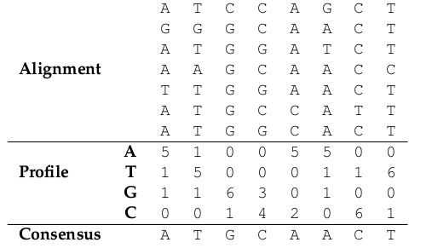
Methodology[2]
3/10
Notes:
Incur an overhead/cost for this reconfigurability; but can make that back by efficient architecture (dataflow)

Slide 4
Methodology (details)
4/10
The DNA sequences are in the superposition as per the problem.
The alignment matrix means the matrix of DNA sequences.
  There are 5 DNA sequences used in the implementation.
Then, profile matrix is calculated.
  By counting the number of As, Ts, Gs, and Cs
  From a column in alignment matrix
Consensus is the string which maximizes the score.
  It is calculated by choosing highest number in column of profile matrix.
  And the character representing that number.

Slide 5
Implementation
5/10
This code is based on two methodologies.
  Data-flow computing[3] and control-flow computing
Initially, random function[4] create 5 random DNA strands.
Then, these strands are passed to DFE() and CPU().
These methods first calculate profile matrices for the data.
  DFE() uses dataflow technique for calculations.
  CPU() uses control flow model.
Based on these matrices, max(score(s,DNA)) is calculated.
  Separately for both
Location in the strand for which the score is maximum is found.
Based on that, consensus string is found and displayed.
Also, checkStopCodons() checks for the occurrences of stop-codons[5].

Slide 6
How to run this Implementation
6/10
This implementation is created using WebIDE
  provided by Maxeler Technologies[6].
It uses ‘typecast template’ which already exists in WebIDE account.
Simply copy the CPUcode and EngineCode into respective files.
Change the value of SIZE and MotifSIZE in the CPUCode to the one you desire.
Delete all pre-existing .max configuration files[7] from :
  CPUCode/results
  RunRules/Simulation/maxfiles
Press ‘BUILD’ button which will compile the code and create graphs, and DFEs.
As this is checking simulation, you will get two results :
  First calculated without using dataflow techniques by CPU( ) method.
  Second calculated using dataflow techniques by DFE( ) method.
The output includes max score, consensus, profile matrices, and status.
Status indicates whether the answer from CPU( ) and DFE( ) are same or not.

Slide 7
What really happens in data-flow
7/10
During one unit of time called a tick,
the Kernel executes a step of computation,
consumes one input value, and
produces one output value.
This is done after creating appropriate graphs.
Hence, the speed is accelerated.

Slide 8
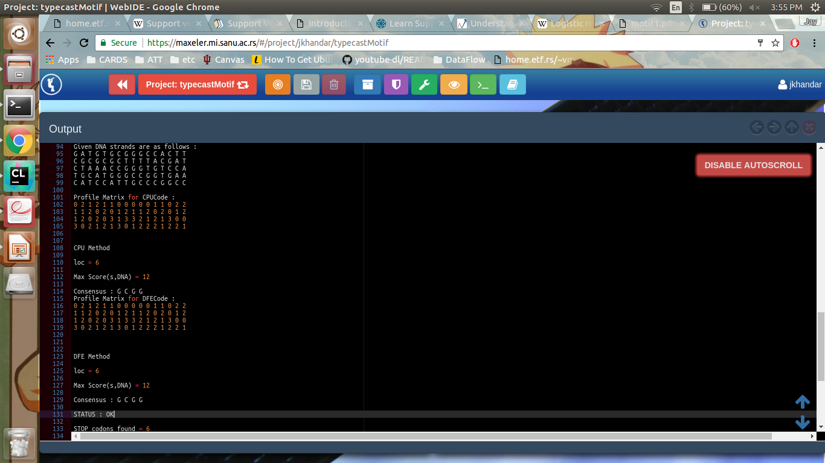
Snapshot of Output
8/10

Slide 9
References
9/10
An Introduction to Bioinformatics Algorithms [page 98]
  – by Neil C. Jones and Pavel A. Pevzner
An Introduction to Bioinformatics Algorithms [page 96]
  – by Neil C. Jones and Pavel A. Pevzner
Instructions provided by Prof. V. Milutinovic
  http://home.etf.rs/~vm/os/vlsi/predavanja/maxeler.html
srand() - standard function available in stdlib.h
Stop-codons (triplets which signify the end of DNA sequences)
https://en.wikipedia.org/wiki/Stop_codon
WebIDE provided by Maxeler Technologies(available: free for students )
  https://maxeler.mi.sanu.ac.rs/
A special thanks to Mr. Ognjen Andric for providing instructions to correct a bug found in WebIDE.
  oandric@maxeler.com
A special thanks to Mr. Saurabh Khandare(M.Sc. Zoology) for explaining DNA structures
  idlesaurabh@gmail.com

Slide 10
About Presenter
10/10
Jayendra Khandare
Graduate Student at School Of Informatics and Computing, Indiana University Bloomington
Created this implementation for :
  CSCI B649 DATAFLOW SUPERCOMPUTING
Course taken for 3 Credits
  under Prof. V. Milutinovic

